Slide 1



Development of the Failure Criteria for Composites
Associate Professorship of Computational Mechanics and Professorship of Wood Technology
Department of Civil, Geo and Environmental Engineering
Technical University of Munich
Software Lab Project 2019 (Group #11)
3rd Review Presentation
Group members:
Panagiotis Gavallas, Yasuyuki Shimizu, Ammar Khallouf
Project Supervisors:
Ani Khaloian
Michael Richter
Prof. Fabian Duddeck (Computational Mechanics Group)
Munich, 06. December 2019

Slide 2
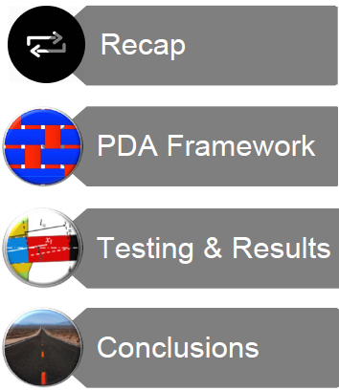
Associate Professorship of Computational Mechanics and Professorship of Wood Technology
Department of Civil, Geo and Environmental Engineering
Technical University of Munich
Outline
Software Lab Project 2019 | Development of Failure Criteria for Composites | 3rd Review

Slide 3
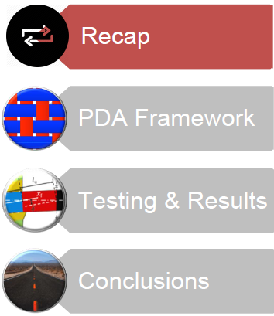
Associate Professorship of Computational Mechanics and Professorship of Wood Technology
Department of Civil, Geo and Environmental Engineering
Technical University of Munich
Software Lab Project 2019 | Development of Failure Criteria for Composites | 3rd Review

Slide 4
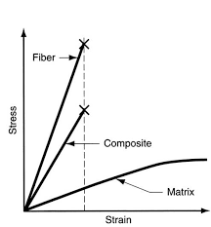
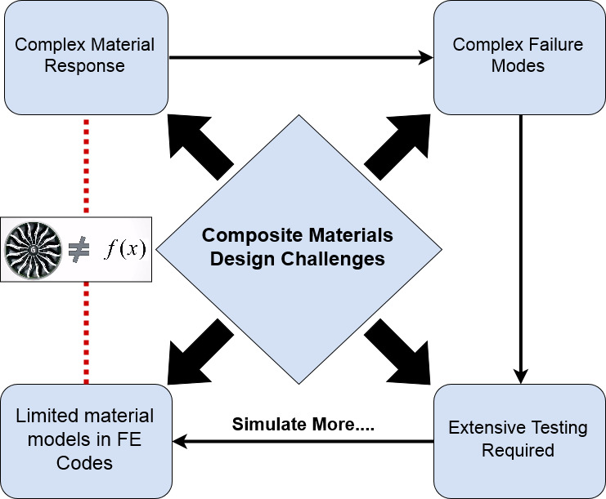
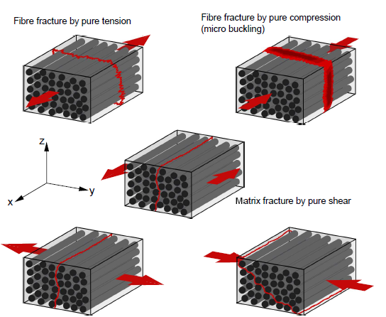
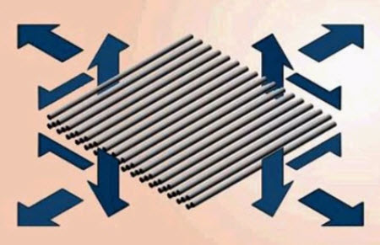

Associate Professorship of Computational Mechanics and Professorship of Wood Technology
Department of Civil, Geo and Environmental Engineering
Technical University of Munich
Recap
Berger, A (2014)

Slide 5
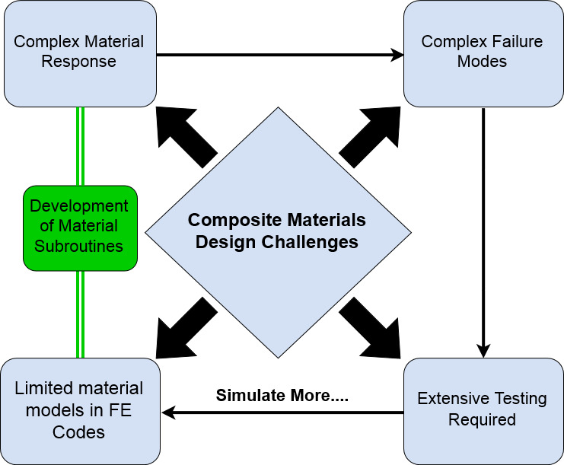

Associate Professorship of Computational Mechanics and Professorship of Wood Technology
Department of Civil, Geo and Environmental Engineering
Technical University of Munich
Recap
Berger, A (2014)

Slide 6
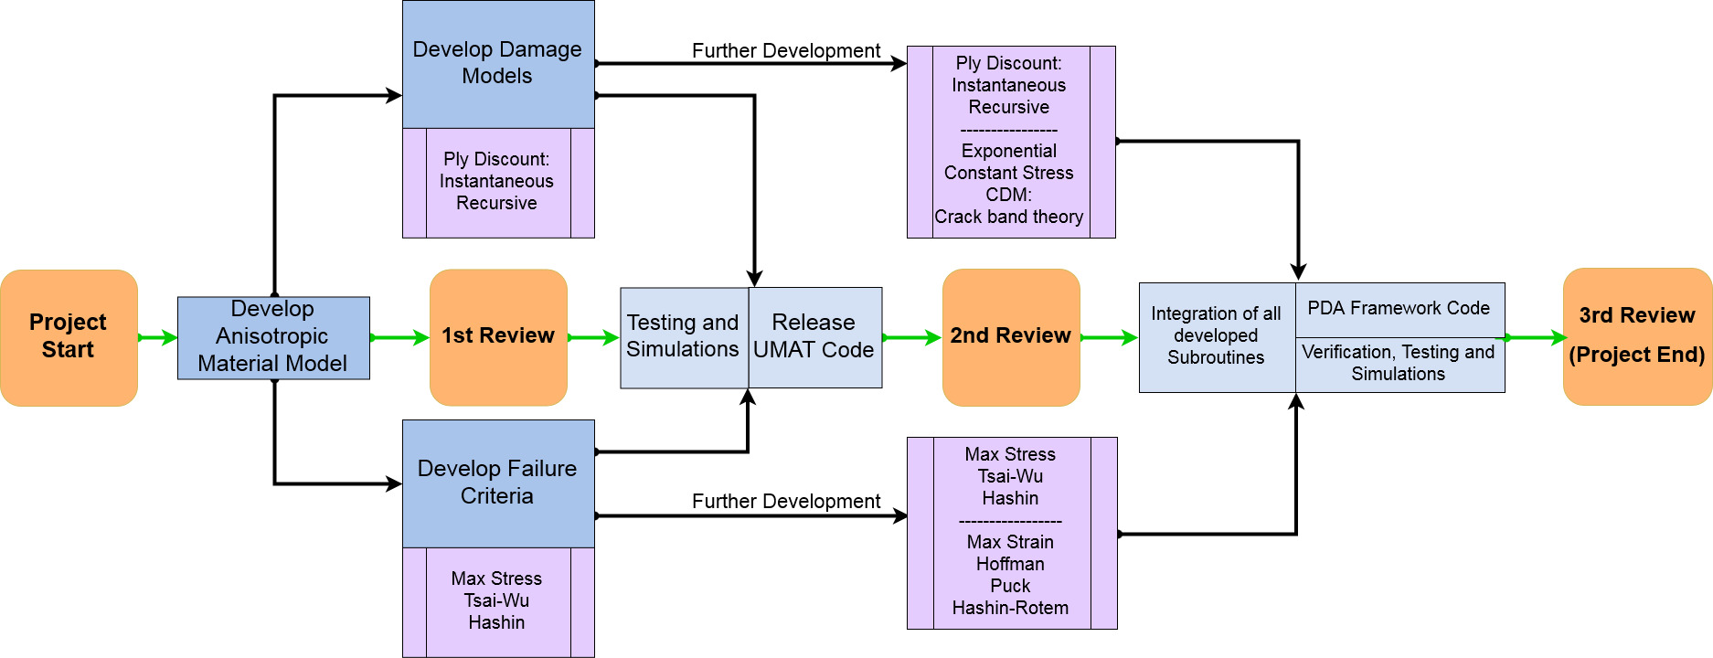
Associate Professorship of Computational Mechanics and Professorship of Wood Technology
Department of Civil, Geo and Environmental Engineering
Technical University of Munich
Recap
Software Lab Project Workflow

Slide 7
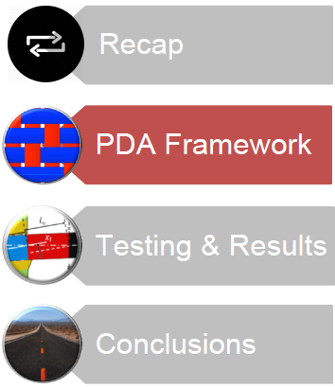
Associate Professorship of Computational Mechanics and Professorship of Wood Technology
Department of Civil, Geo and Environmental Engineering
Technical University of Munich
Software Lab Project 2019 | Development of Failure Criteria for Composites | 3rd Review

Slide 8
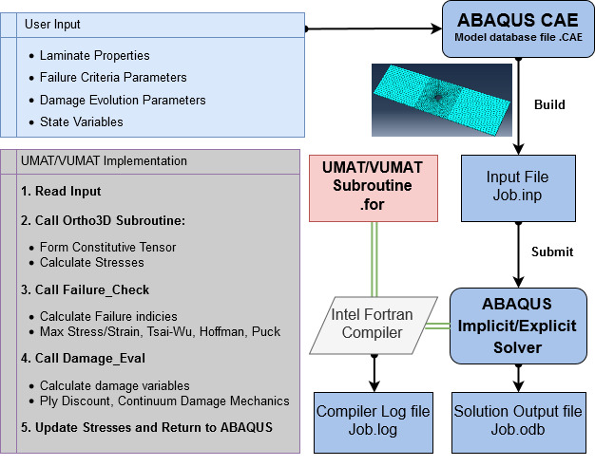
PDA Framework
Associate Professorship of Computational Mechanics and Professorship of Wood Technology
Department of Civil, Geo and Environmental Engineering
Technical University of Munich

Slide 9
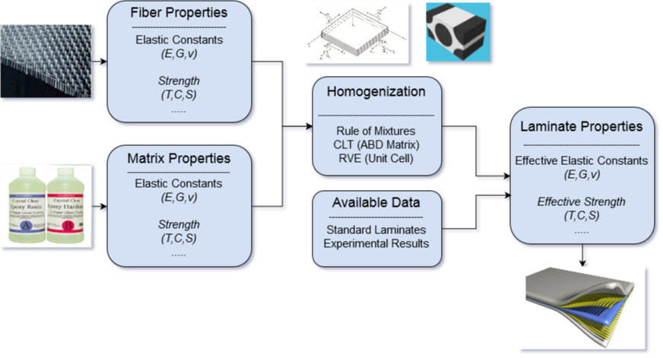
PDA Framework
Associate Professorship of Computational Mechanics and Professorship of Wood Technology
Department of Civil, Geo and Environmental Engineering
Technical University of Munich
Constitutive Law
Data flow for determining laminate elastic properties
Khallouf, A (2019)

Slide 10
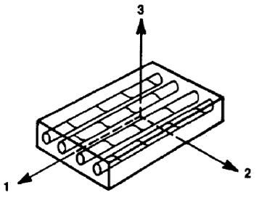
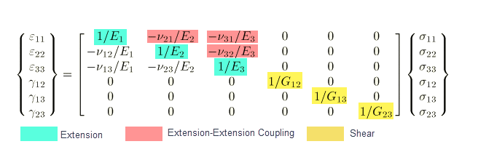
PDA Framework
Associate Professorship of Computational Mechanics and Professorship of Wood Technology
Department of Civil, Geo and Environmental Engineering
Technical University of Munich
Constitutive Law
General Hooke's Law for orthotropic elasticity
Explicit consideration for 3D stress states
Definition of Laminate coordinate system
Jones, R. M. (2014)
Stress-Strain relations for orthotropic material (ABAQUS Manual 2003)
User Input : Elastic Constants, Material Local axis

Slide 11
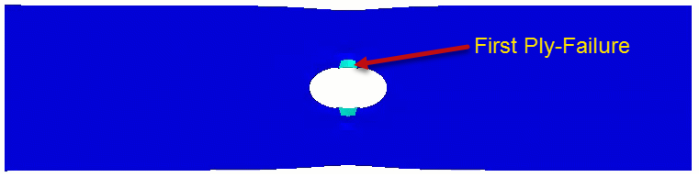
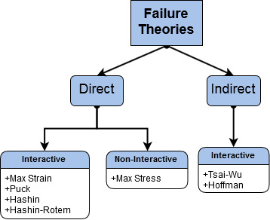
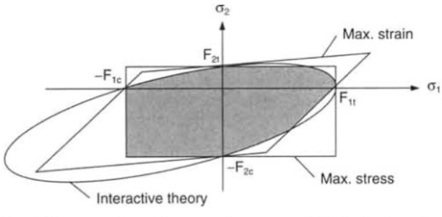
PDA Framework
Associate Professorship of Computational Mechanics and Professorship of Wood Technology
Department of Civil, Geo and Environmental Engineering
Technical University of Munich
Failure Criteria
T300/5208 Graphite/epoxy Laminate
Fiber Tensile Failure -Hashin Criteria
(Daniel,1994)
User Input : Material Allowable Stresses/Strains
Illustration of different failure theories

Slide 12
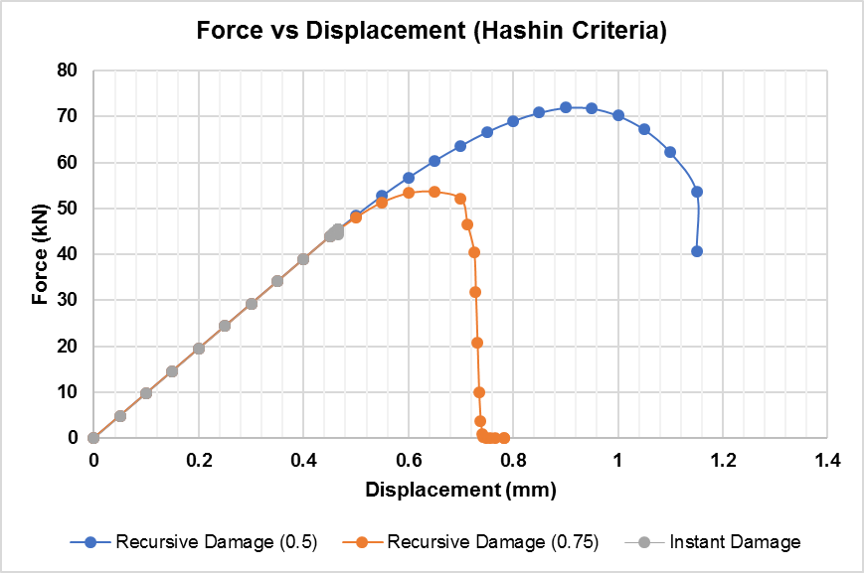
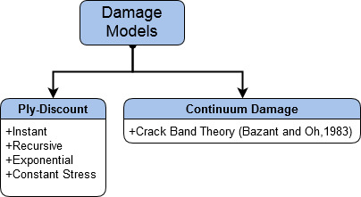
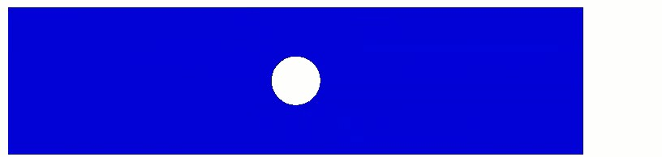
PDA Framework
Associate Professorship of Computational Mechanics and Professorship of Wood Technology
Department of Civil, Geo and Environmental Engineering
Technical University of Munich
Damage Propagation
T300/5208 Graphite/epoxy Laminate
Fiber Tensile Progressive Damage-Hashin Criteria
Effects of different damage parameters
on ultimate load of composite laminate
User Input : (Fiber & Matrix Degradation Factors / Fracture Energies)

Slide 13
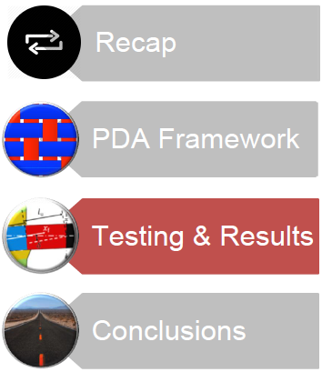
Associate Professorship of Computational Mechanics and Professorship of Wood Technology
Department of Civil, Geo and Environmental Engineering
Technical University of Munich
Outline
Software Lab Project 2019 | Development of Failure Criteria for Composites | 3rd Review

Slide 14
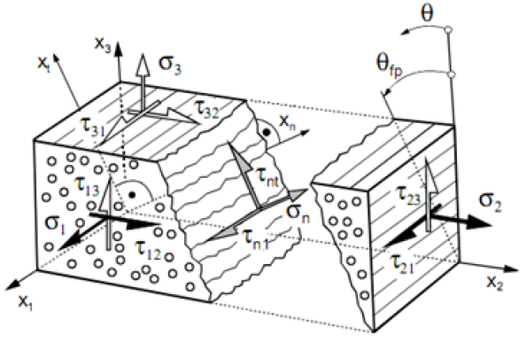
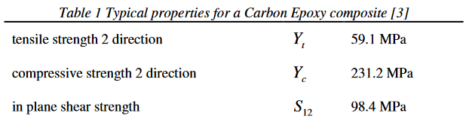
Testing & Results
Associate Professorship of Computational Mechanics and Professorship of Wood Technology
Department of Civil, Geo and Environmental Engineering
Technical University of Munich
WWFE (Worldwide Failure Exercise ):
Reference: Hinton, M. J. K. A., Kaddour, A. S., & Soden, P. D. (Eds.). (2004)
Verification of Puck Criteria Implementation for Inter Fiber Failure
Predict the fracture plane oreientation for Carbon Epoxy composite
Cuntze ,RG et al ,1997
Illustration of Puck action Plane
(Puck & Shurmann,1998)

Slide 15
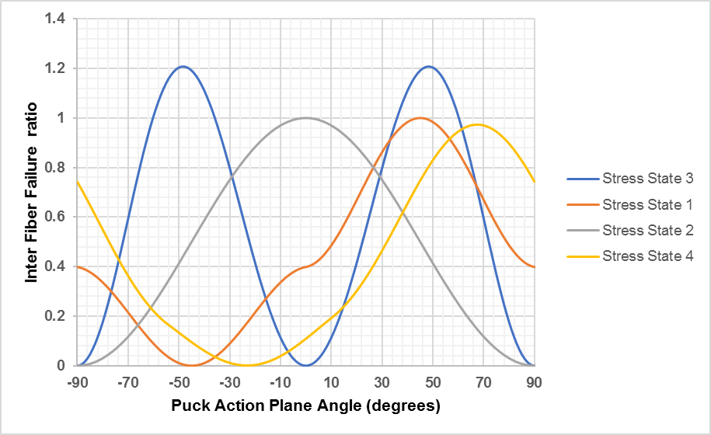
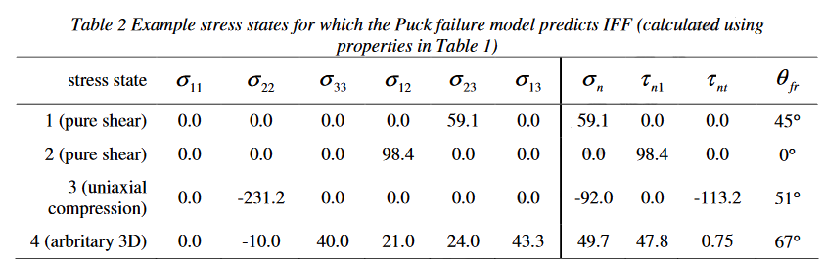
Testing & Results
Associate Professorship of Computational Mechanics and Professorship of Wood Technology
Department of Civil, Geo and Environmental Engineering
Technical University of Munich
Cuntze ,RG et al ,1997

Slide 16
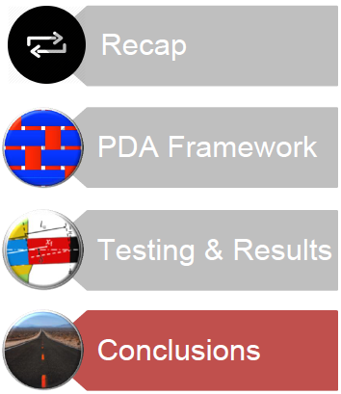
Associate Professorship of Computational Mechanics and Professorship of Wood Technology
Department of Civil, Geo and Environmental Engineering
Technical University of Munich

Slide 17
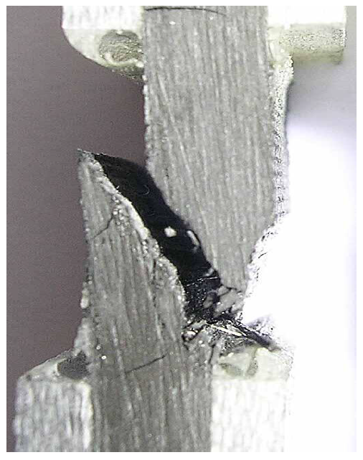
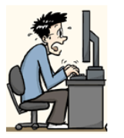
Conclusions
Associate Professorship of Computational Mechanics and Professorship of Wood Technology
Department of Civil, Geo and Environmental Engineering
Technical University of Munich
Mechanical response of composites
-There is a lot we still don’t know, but there is a lot we have learnt
Modelling of mechanical response:
-Increasing use for design
-Potential for integration with manufacturing
Development of material subroutines:
-Bridge the gap between academia, industry
and the software houses in this domain
-Writing user subroutines is not an easy process….
(Pinho,2014)
(Korelc,2014)

Slide 18
References
Associate Professorship of Computational Mechanics and Professorship of Wood Technology
Department of Civil, Geo and Environmental Engineering
Technical University of Munich
Kaw, A. K. (2005). Mechanics of composite materials. CRC press.
Carrera, E. (2018). Implementation of classical and advanced failure criteria for composite layered structures in FEMAP and assessment of results (Doctoral dissertation, Politecnico di Torino).
Cuntze RG, Deska R, Szelinski B, JeltschFricker R, Meckbach S, Huybrechts D, Kopp J, Kroll L, Gollwitzer S, Rackwitz R. Neue Bruchkriterien und Festigkeitsnachweise fuer unidirektionalen Faserkunststoffverbund unter mehrachsiger Beanspruchung -Modellbildung und Experimente. In: VDI Fortschritt-Berichte. Duesseldorf: VDI Verlag, 1997
Berger, A. (2014). Numerical Modelling of Composite Materials Based on a Combined Manufacturing-Crash Simulation(Doctoral dissertation, Queen Mary University of London).
Abaqus, U. S. M., & Manuals, E. U. S. (2002). Version 6.3, Hibbitt, Karlsson & Sorensen. Inc. Rhode Island.

Slide 19
References
Associate Professorship of Computational Mechanics and Professorship of Wood Technology
Department of Civil, Geo and Environmental Engineering
Technical University of Munich
3ds.com. (2019). Writing User Subroutines with Abaqus. [online] Available at: https://www.3ds.com/products-services/simulia/services/training-courses/course-descriptions/writing-user-subroutines-with-abaqus/ [Accessed 17 May 2019].
Systèmes, D. (2010). Abaqus 6.10 online documentation. Abaqus User Subroutines Reference Manual.
Knight Jr, N. F., & Reeder, J. R. (2006). User-defined material model for progressive failure analysis.
Larry Pearce, Sr.Lead application engineer, MSC Software, ʻʻProgressive ply failure in composites,ʼʼ Webinar on May 15, 2012
Wiegand, J., Petrinic, N., & Elliott, B. (2008). An algorithm for determination of the fracture angle for the three-dimensional Puck matrix failure criterion for UD composites. Composites Science and Technology, 68(12), 2511-2517.

Slide 20

Questions ?
Associate Professorship of Computational Mechanics and Professorship of Wood Technology
Department of Civil, Geo and Environmental Engineering
Technical University of Munich

Slide 21
Backup Slides
Associate Professorship of Computational Mechanics and Professorship of Wood Technology
Department of Civil, Geo and Environmental Engineering
Technical University of Munich

Slide 22
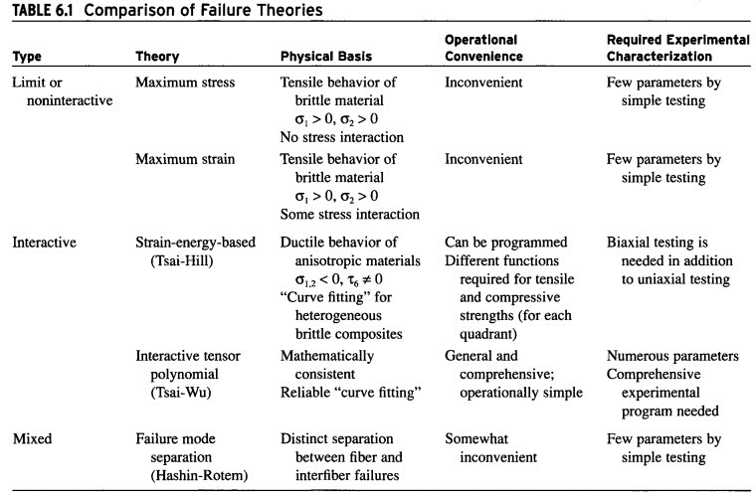
Comparison:
Associate Professorship of Computational Mechanics and Professorship of Wood Technology
Department of Civil, Geo and Environmental Engineering
Technical University of Munich

Slide 23
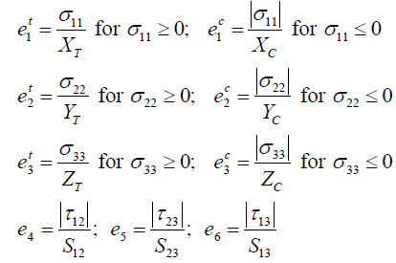

Max Stress Theory
Associate Professorship of Computational Mechanics and Professorship of Wood Technology
Department of Civil, Geo and Environmental Engineering
Technical University of Munich
State Variables and Failure Index:

Slide 24
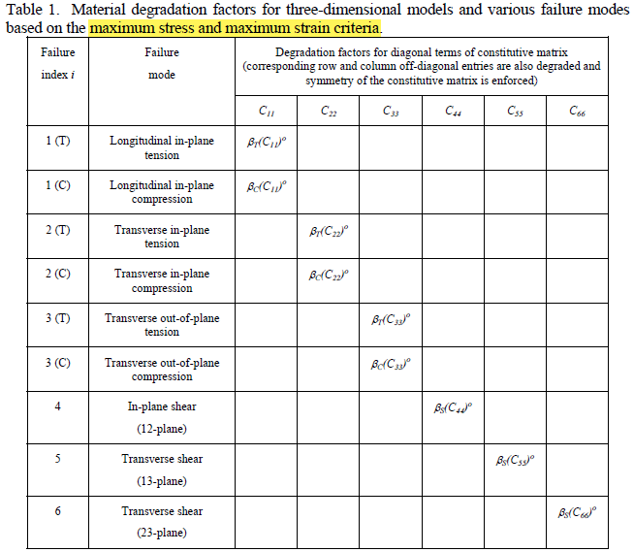
Damage Development
Associate Professorship of Computational Mechanics and Professorship of Wood Technology
Department of Civil, Geo and Environmental Engineering
Technical University of Munich

Slide 25
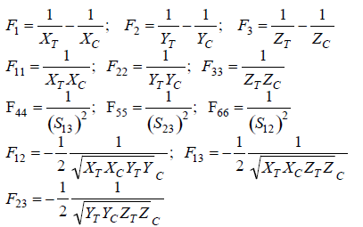
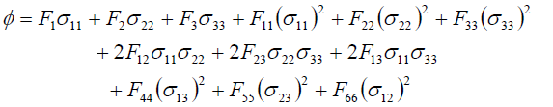

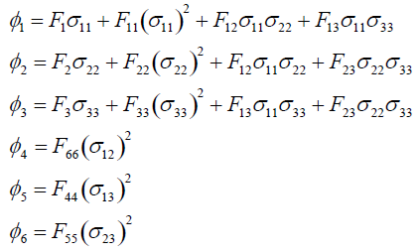

Tsai-Wu Theory
Associate Professorship of Computational Mechanics and Professorship of Wood Technology
Department of Civil, Geo and Environmental Engineering
Technical University of Munich
State Variables and Failure Index:

Slide 26

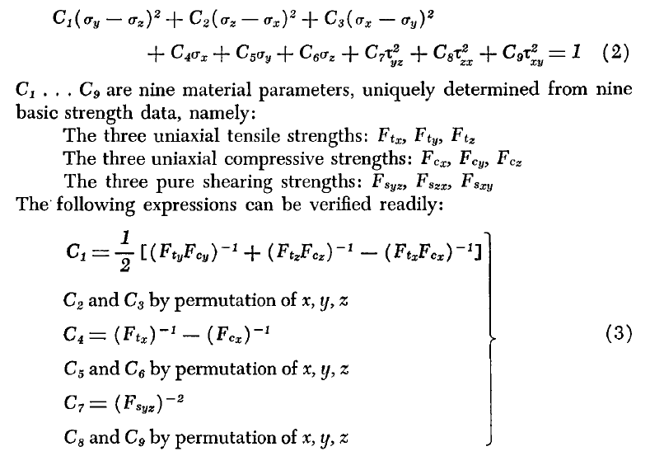
Hoffman Theory
Associate Professorship of Computational Mechanics and Professorship of Wood Technology
Department of Civil, Geo and Environmental Engineering
Technical University of Munich
State Variables and Failure Index:

Slide 27
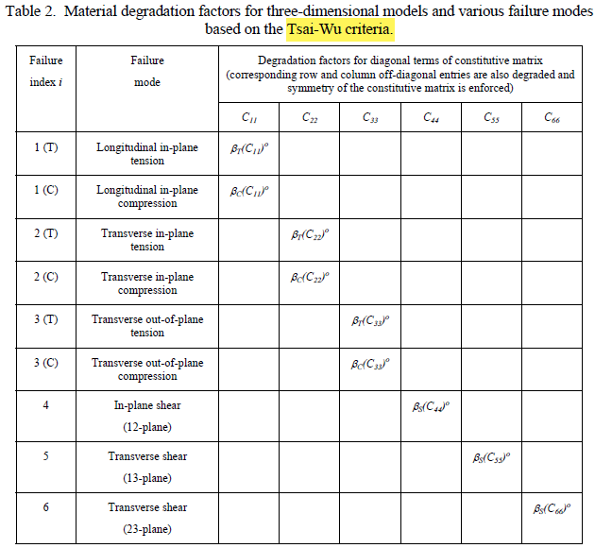
Damage Development
Associate Professorship of Computational Mechanics and Professorship of Wood Technology
Department of Civil, Geo and Environmental Engineering
Technical University of Munich

Slide 28
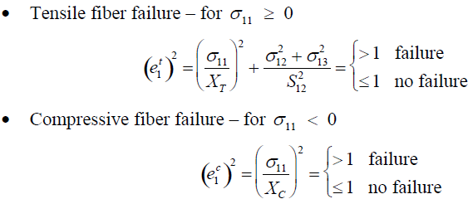
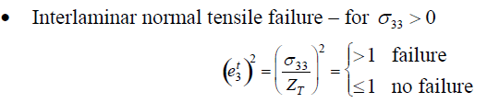
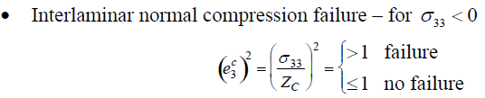
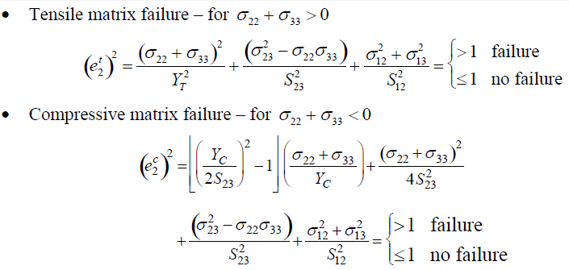
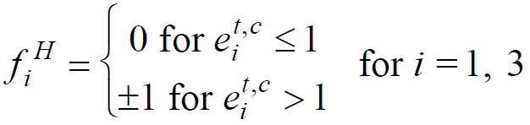
Hashin Theory
Associate Professorship of Computational Mechanics and Professorship of Wood Technology
Department of Civil, Geo and Environmental Engineering
Technical University of Munich
State Variables and Failure Index:

Slide 29
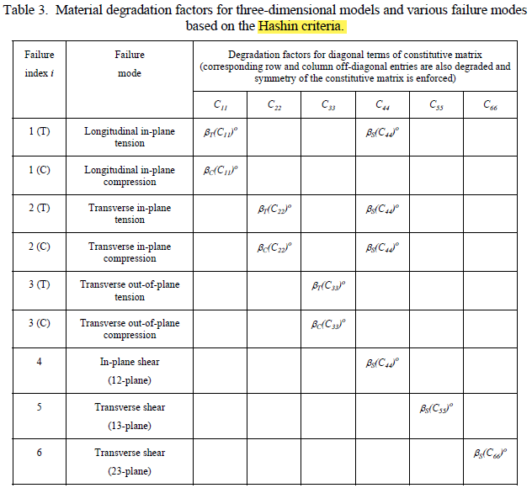
Damage Development
Associate Professorship of Computational Mechanics and Professorship of Wood Technology
Department of Civil, Geo and Environmental Engineering
Technical University of Munich

Slide 30
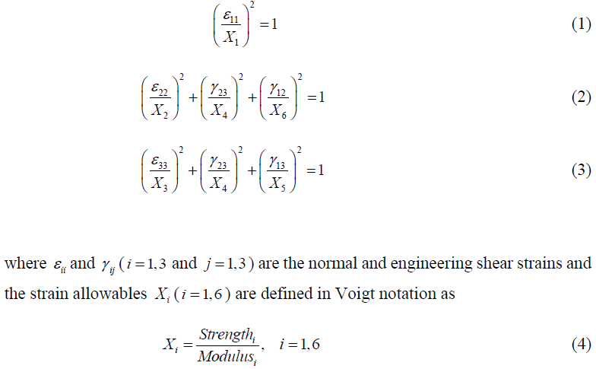
Hashin-Rotem Theory
Associate Professorship of Computational Mechanics and Professorship of Wood Technology
Department of Civil, Geo and Environmental Engineering
Technical University of Munich
State Variables and Failure Index:

Slide 31

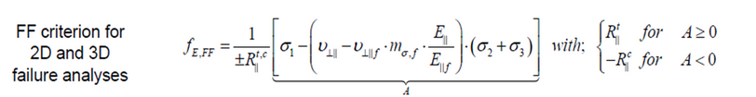
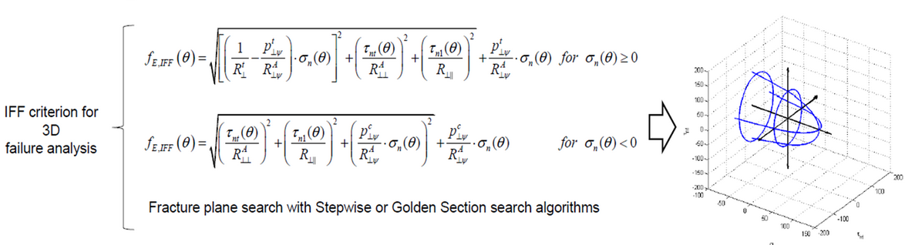
Puck Theory
Associate Professorship of Computational Mechanics and Professorship of Wood Technology
Department of Civil, Geo and Environmental Engineering
Technical University of Munich
State Variables and Failure Index:

Slide 32
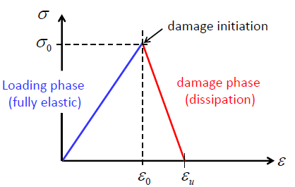
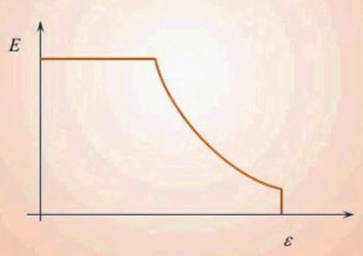
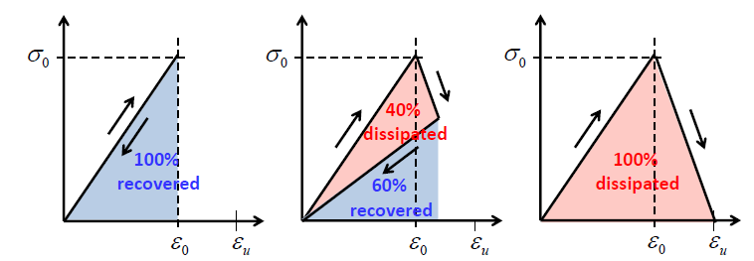
Damage Development
Associate Professorship of Computational Mechanics and Professorship of Wood Technology
Department of Civil, Geo and Environmental Engineering
Technical University of Munich

Slide 33
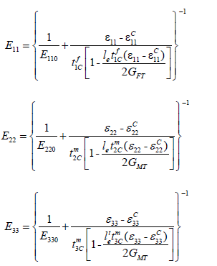
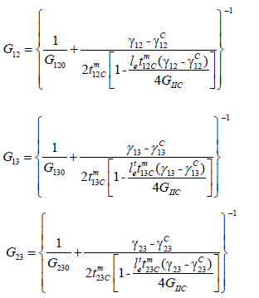
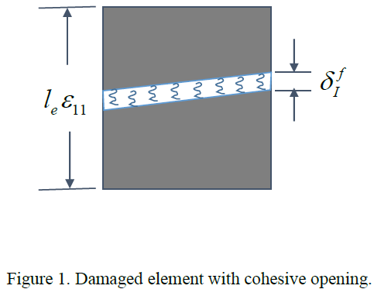
Crack Band Theory
Associate Professorship of Computational Mechanics and Professorship of Wood Technology
Department of Civil, Geo and Environmental Engineering
Technical University of Munich

Slide 34


Crack Band Theory
Associate Professorship of Computational Mechanics and Professorship of Wood Technology
Department of Civil, Geo and Environmental Engineering
Technical University of Munich

Slide 35



Crack Band Theory
Associate Professorship of Computational Mechanics and Professorship of Wood Technology
Department of Civil, Geo and Environmental Engineering
Technical University of Munich

Slide 36

Crack Band Theory
Associate Professorship of Computational Mechanics and Professorship of Wood Technology
Department of Civil, Geo and Environmental Engineering
Technical University of Munich

Slide 37

Crack Band Theory
Associate Professorship of Computational Mechanics and Professorship of Wood Technology
Department of Civil, Geo and Environmental Engineering
Technical University of Munich

Slide 38


Homogenization vs MCT :
Associate Professorship of Computational Mechanics and Professorship of Wood Technology
Department of Civil, Geo and Environmental Engineering
Technical University of Munich

Slide 39

Macro to Micro Scale:
Associate Professorship of Computational Mechanics and Professorship of Wood Technology
Department of Civil, Geo and Environmental Engineering
Technical University of Munich

Slide 40

UMAT Micro Scale :
Associate Professorship of Computational Mechanics and Professorship of Wood Technology
Department of Civil, Geo and Environmental Engineering
Technical University of Munich

Slide 41

Progressive Failure Analysis:
Associate Professorship of Computational Mechanics and Professorship of Wood Technology
Department of Civil, Geo and Environmental Engineering
Technical University of Munich

Slide 42

ABAQUS/UMAT Implementation:
Associate Professorship of Computational Mechanics and Professorship of Wood Technology
Department of Civil, Geo and Environmental Engineering
Technical University of Munich

Slide 43


Further Developments
Associate Professorship of Computational Mechanics and Professorship of Wood Technology
Department of Civil, Geo and Environmental Engineering
Technical University of Munich
PDALAC Interface :
-Standalone testing program
-Console Output
-Linked with GNU plot

